Slide 1
Pipeline Hazards
Textbook Chapter 4 – The Processor
Lecture 26

Slide 2
Data Hazard – Example 4
Make pipeline diagram for the code segment given below, and identify data hazards
lw $s0, 20($t1)
sub $t2, $s0, $t3

Slide 3
Data Hazard – Example 4 (contd.)
Make pipeline diagram for the code segment given below, and identify data hazards
Solution:
lw $s0, 20($t1)
sub $t2, $s0, $t3
 | CC1 | CC2 | CC3 | CC4 | CC5 | CC6 | CC7
lw $s0, 20($t1) | IF | ID | EX | MEM | WB
sub $t2, $s0, $t3 |  | IF | ID | EX | MEM | WB

Slide 4
Data Hazard – Example 4 (contd.)
Make pipeline diagram for the code segment given below, and identify data hazards
Solution:
lw $s0, 20($t1)
sub $t2, $s0, $t3
Find Dependences
 | CC1 | CC2 | CC3 | CC4 | CC5 | CC6 | CC7
lw $s0, 20($t1) | IF | ID | EX | MEM | WB
sub $t2, $s0, $t3 |  | IF | ID | EX | MEM | WB
Is Forwarding possible?

Slide 5
Data Hazard – Example 4 (contd.)
Make pipeline diagram for the code segment given below, and identify data hazards
Solution:
lw $s0, 20($t1)
sub $t2, $s0, $t3
Find Dependences
 | CC1 | CC2 | CC3 | CC4 | CC5 | CC6 | CC7
lw $s0, 20($t1) | IF | ID | EX | MEM | WB
sub $t2, $s0, $t3 |  | IF | ID | EX | MEM | WB
Solution: Stall the pipeline

Slide 6
Data Hazard – Example 4 (contd.)
Make pipeline diagram for the code segment given below, and identify data hazards
Solution:
lw $s0, 20($t1)
sub $t2, $s0, $t3
Find Dependences
 | CC1 | CC2 | CC3 | CC4 | CC5 | CC6 | CC7
lw $s0, 20($t1) | IF | ID | EX | MEM | WB
sub $t2, $s0, $t3 |  | IF | ID |  | EX | MEM | WB
Solution: Stall the pipeline

Slide 7
Data Hazard – Example 4 (contd.)
Make pipeline diagram for the code segment given below, and identify data hazards
Solution:
lw $s0, 20($t1)
sub $t2, $s0, $t3
Find Dependences
 | CC1 | CC2 | CC3 | CC4 | CC5 | CC6 | CC7
lw $s0, 20($t1) | IF | ID | EX | MEM | WB
sub $t2, $s0, $t3 |  | IF | ID | Stall | Stall | Stall
sub $t2, $s0, $t3 |  |  |  |  | EX | MEM | WB
Solution: Stall the pipeline

Slide 8
Data Hazard – Example 4 (contd.)
Make pipeline diagram for the code segment given below, and identify data hazards
Solution:
lw $s0, 20($t1)
sub $t2, $s0, $t3
Find Dependences
 | CC1 | CC2 | CC3 | CC4 | CC5 | CC6 | CC7
lw $s0, 20($t1) | IF | ID | EX | MEM | WB
sub $t2, $s0, $t3 |  | IF | ID | Stall | Stall | Stall
sub $t2, $s0, $t3 |  | IF | ID | ID | EX | MEM | WB
Solution: Stall the pipeline

Slide 9
Data Hazard – Example 4 (contd.)
Make pipeline diagram for the code segment given below, and identify data hazards
Solution:
lw $s0, 20($t1)
sub $t2, $s0, $t3
Find Dependences
 | CC1 | CC2 | CC3 | CC4 | CC5 | CC6 | CC7
lw $s0, 20($t1) | IF | ID | EX | MEM | WB
 |  | Stall | Stall | Stall | Stall | Stall
sub $t2, $s0, $t3 |  |  | IF | ID | EX | MEM | WB
Solution: Stall the pipeline

Slide 10
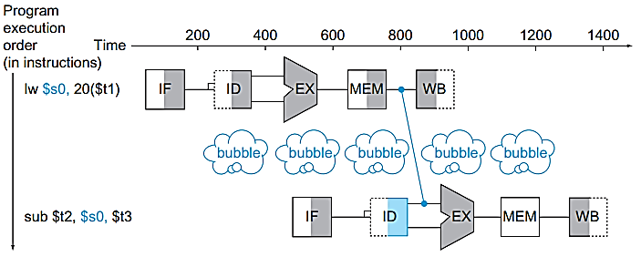
Data Hazard – Example 4 Pipeline Stall (Bubble)
CC1
CC2
CC3
CC4
CC5
CC6
CC7
we cannot know until after the subtract instruction is fetched and decoded whether or not a stall will be necessary
Notes:
FIGURE 4.30 We need a stall even with forwarding when an R-format instruction following a load tries to use the data. Without the stall, the path from memory access stage output to execution stage input would be going backward in time, which is impossible. Th is fi gure is actually a simplifi cation, since we cannot know until aft er the subtract instruction is fetched and decoded whether or not a stall will be necessary. Section 4.7 shows the details of what really happens in the case of a hazard.

Slide 11
Data Hazard – Example 5
Make pipeline diagram for the code segment given below, and identify data dependences and hazards.
lw $2, 20($1)
and $4, $2, $5
or $8, $2, $6
add $9, $4, $2
slt $1, $6, $7

Slide 12
Data Hazard – Example 5
Make pipeline diagram for the code segment given below, and identify data dependences and hazards.
Solution:
lw $2, 20($1)
and $4, $2, $5
or $8, $2, $6
add $9, $4, $2
slt $1, $6, $7
Check and fix (if required) the $4 dependency yourself.

Slide 13
Data Hazard – Example 5 (contd.)
lw $2, 20($1)
and $4, $2, $5
or $8, $2, $6
add $9, $4, $2
slt $1, $6, $7
 | CC1
lw $2, 20($1) | IF

Slide 14
Data Hazard – Example 5 (contd.)
lw $2, 20($1)
and $4, $2, $5
or $8, $2, $6
add $9, $4, $2
slt $1, $6, $7
 | CC1 | CC2
lw $2, 20($1) | IF | ID
and $4, $2, $5 |  | IF

Slide 15
Data Hazard – Example 5 (contd.)
lw $2, 20($1)
and $4, $2, $5
or $8, $2, $6
add $9, $4, $2
slt $1, $6, $7
 | CC1 | CC2 | CC3
lw $2, 20($1) | IF | ID | EX
and $4, $2, $5 |  | IF | ID
or $8, $2, $6 |  |  | IF
Assume there is no dependency, how will pipelining work?

Slide 16
Data Hazard – Example 5 (contd.)
lw $2, 20($1)
and $4, $2, $5
or $8, $2, $6
add $9, $4, $2
slt $1, $6, $7
 | CC1 | CC2 | CC3 | CC4 | CC5 | CC6 | CC7
lw $2, 20($1) | IF | ID | EX | MEM | WB
and $4, $2, $5 |  | IF | ID | EX | MEM | WB
or $8, $2, $6 |  |  | IF | ID | EX | MEM | WB
Assume there is no dependency, how will pipelining work?

Slide 17
Data Hazard – Example 5 (contd.)
lw $2, 20($1)
and $4, $2, $5
or $8, $2, $6
add $9, $4, $2
slt $1, $6, $7
 | CC1 | CC2 | CC3 | CC4 | CC5 | CC6 | CC7 | CC8 | CC9
lw $2, 20($1) | IF | ID | EX | MEM | WB
and $4, $2, $5 |  | IF | ID | EX | MEM | WB
or $8, $2, $6 |  |  | IF | ID | EX | MEM | WB
add $9, $4, $2 |  |  |  | IF | ID | EX | MEM | WB
slt $1, $6, $7 |  |  |  |  | IF | ID | EX | MEM | WB
Assume there is no dependency, how will pipelining work?

Slide 18
Data Hazard – Example 5 (contd.)
lw $2, 20($1)
and $4, $2, $5
or $8, $2, $6
add $9, $4, $2
slt $1, $6, $7
 | CC1 | CC2 | CC3
lw $2, 20($1) | IF | ID | EX
and $4, $2, $5 |  | IF | ID
or $8, $2, $6 |  |  | IF
At ID of “and $4, $2, $5”, we get to know that we have to stall its EX
“or $8, $2, $6 ” is already in pipeline, this should not be missed

Slide 19
Data Hazard – Example 5 (contd.)
lw $2, 20($1)
and $4, $2, $5
or $8, $2, $6
add $9, $4, $2
slt $1, $6, $7
 | CC1 | CC2 | CC3 | CC4 | CC5
lw $2, 20($1) | IF | ID | EX | MEM | WB
and $4, $2, $5 |  | IF | ID |  | EX
or $8, $2, $6 |  |  | IF
At ID of “and $4, $2, $5”, we get to know that we have to stall its EX
“or $8, $2, $6 ” is already in pipeline, this should not be missed
At CC5, we can execute “and $4, $2, $5” having Mem content forwarded from Mem/WB Register

Slide 20
Data Hazard – Example 5 (contd.)
lw $2, 20($1)
and $4, $2, $5
or $8, $2, $6
add $9, $4, $2
slt $1, $6, $7
 | CC1 | CC2 | CC3 | CC4 | CC5 | CC6 | CC7
lw $2, 20($1) | IF | ID | EX | MEM | WB
and $4, $2, $5 |  | IF | ID |  | EX | MEM | WB
or $8, $2, $6 |  |  | IF
At ID of “and $4, $2, $5”, we get to know that we have to stall its EX
“or $8, $2, $6 ” is already in pipeline, this should not be missed
At CC5, we can execute “and $4, $2, $5” having Mem content forwarded from Mem/WB Register

Slide 21
Data Hazard – Example 5 (contd.)
lw $2, 20($1)
and $4, $2, $5
or $8, $2, $6
add $9, $4, $2
slt $1, $6, $7
 | CC1 | CC2 | CC3 | CC4 | CC5 | CC6 | CC7
lw $2, 20($1) | IF | ID | EX | MEM | WB
and $4, $2, $5 |  | IF | ID |  | EX | MEM | WB
or $8, $2, $6 |  |  | IF
At ID of “and $4, $2, $5”, we get to know that we have to stall its EX
“or $8, $2, $6 ” is already in pipeline, this should not be missed
At CC5, we can execute “and $4, $2, $5” having Mem content forwarded from Mem/WB Register
We need to stop “or $8, $2, $6 ” at IF at CC4

Slide 22
Data Hazard – Example 5 (contd.)
lw $2, 20($1)
and $4, $2, $5
or $8, $2, $6
add $9, $4, $2
slt $1, $6, $7
 | CC1 | CC2 | CC3 | CC4 | CC5 | CC6 | CC7
lw $2, 20($1) | IF | ID | EX | MEM | WB
and $4, $2, $5 |  | IF | ID |  | EX | MEM | WB
or $8, $2, $6 |  |  | IF |  | ID | EX | MEM | WB
At ID of “and $4, $2, $5”, we get to know that we have to stall its EX
“or $8, $2, $6 ” is already in pipeline, this should not be missed
At CC5, we can execute “and $4, $2, $5” having Mem content forwarded from Mem/WB Register
We need to stop “or $8, $2, $6 ” at IF at CC4

Slide 23
Data Hazard – Example 5 (contd.)
lw $2, 20($1)
and $4, $2, $5
or $8, $2, $6
add $9, $4, $2
slt $1, $6, $7
 | CC1 | CC2 | CC3 | CC4 | CC5 | CC6 | CC7
lw $2, 20($1) | IF | ID | EX | MEM | WB
and $4, $2, $5 |  | IF | ID | ID | EX | MEM | WB
or $8, $2, $6 |  |  | IF | IF | ID | EX | MEM | WB
In CC3 we have to do following
Keep and in ID at CC4
Keep or in IF at CC4

Slide 24
Data Hazard – Example 5 (contd.)
lw $2, 20($1)
and $4, $2, $5
or $8, $2, $6
add $9, $4, $2
slt $1, $6, $7
 | CC1 | CC2 | CC3 | CC4 | CC5 | CC6 | CC7 | CC8 | CC9 | CC10
lw $2, 20($1) | IF | ID | EX | MEM | WB
and $4, $2, $5 |  | IF | ID | ID | EX | MEM | WB
or $8, $2, $6 |  |  | IF | IF | ID | EX | MEM | WB
add $9, $4, $2 |  |  |  |  | IF | ID | EX | MEM | WB
slt $1, $6, $7 |  |  |  |  |  | IF | ID | EX | MEM | WB

Slide 25
Data Hazard – Example 5 (contd.)
lw $2, 20($1)
and $4, $2, $5
or $8, $2, $6
add $9, $4, $2
slt $1, $6, $7
Requirements:
1- We need to stop PC from changing. Don’t let “add $9, $4, $2” in.
2- Hold “IF/ID” Pipeline register to keep “or $8, $2, $6 ”
3- Hold “ID/EX” to execute “and $4, $2, $5”
 | CC1 | CC2 | CC3 | CC4 | CC5 | CC6 | CC7 | CC8 | CC9 | CC10
lw $2, 20($1) | IF | ID | EX | MEM | WB
and $4, $2, $5 |  | IF | ID | ID | EX | MEM | WB
or $8, $2, $6 |  |  | IF | IF | ID | EX | MEM | WB
add $9, $4, $2 |  |  |  |  | IF | ID | EX | MEM | WB
slt $1, $6, $7 |  |  |  |  |  | IF | ID | EX | MEM | WB

Slide 26
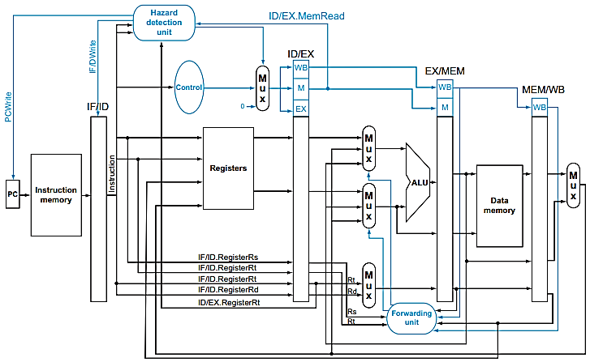
Stall
Implementation
Notes:
FIGURE 4.60 Pipelined control overview, showing the two multiplexors for forwarding, the hazard detection unit, and the forwarding unit. Although the ID and EX stages have been simplifi ed—the sign-extended immediate and branch logic are missing— this drawing gives the essence of the forwarding hardware requirements.

Slide 27
ID.rs
ID.rt
EX.rt
Stall
Implementation
Notes:
FIGURE 4.60 Pipelined control overview, showing the two multiplexors for forwarding, the hazard detection unit, and the forwarding unit. Although the ID and EX stages have been simplifi ed—the sign-extended immediate and branch logic are missing— this drawing gives the essence of the forwarding hardware requirements.

Slide 28
ID.rs
ID.rt
EX.rt
Stall
Implementation
Notes:
FIGURE 4.60 Pipelined control overview, showing the two multiplexors for forwarding, the hazard detection unit, and the forwarding unit. Although the ID and EX stages have been simplified—the sign-extended immediate and branch logic are missing— this drawing gives the essence of the forwarding hardware requirements.

Slide 29
Data Hazard – Example 5 (contd.)
lw $2, 20($1)
and $4, $2, $5
or $8, $2, $6
add $9, $4, $2
slt $1, $6, $7
 | CC1 | CC2 | CC3 | CC4 | CC5 | CC6 | CC7 | CC8 | CC9 | CC10
lw $2, 20($1) | IF | ID | EX | MEM | WB
and $4, $2, $5 |  | IF | ID | ID | EX | MEM | WB
or $8, $2, $6 |  |  | IF | IF | ID | EX | MEM | WB
add $9, $4, $2 |  |  |  |  | IF | ID | EX | MEM | WB
slt $1, $6, $7 |  |  |  |  |  | IF | ID | EX | MEM | WB
Stall = Bubble
 | CC1 | CC2 | CC3 | CC4 | CC5 | CC6 | CC7 | CC8 | CC9 | CC10
lw $2, 20($1) | IF | ID | EX | MEM | WB
and $4, $2, $5 (become NOP) |  | IF | ID | STAL in EX | STALL in Mem | STALL in WB
and $4, $2, $5 |  |  |  | ID | EX | MEM | WB
or $8, $2, $6 |  |  | IF | IF | ID | EX | MEM | WB
add $9, $4, $2 |  |  |  |  | IF | ID | EX | MEM | WB
slt $1, $6, $7 |  |  |  |  |  | IF | ID | EX | MEM | WB
Another
Way
To show the
Same
Execution

Slide 30
Data Hazard – Example 5 (contd.)
lw $2, 20($1)
and $4, $2, $5
or $8, $2, $6
add $9, $4, $2
slt $1, $6, $7
 | CC1 | CC2 | CC3 | CC4 | CC5 | CC6 | CC7 | CC8 | CC9 | CC10
lw $2, 20($1) | IF | ID | EX | MEM | WB
and $4, $2, $5 |  | IF | ID | ID | EX | MEM | WB
or $8, $2, $6 |  |  | IF | IF | ID | EX | MEM | WB
add $9, $4, $2 |  |  |  |  | IF | ID | EX | MEM | WB
slt $1, $6, $7 |  |  |  |  |  | IF | ID | EX | MEM | WB
 | CC1 | CC2 | CC3 | CC4 | CC5 | CC6 | CC7 | CC8 | CC9 | CC10
lw $2, 20($1) | IF | ID | EX | MEM | WB
nop |  | STALL | STALL | STALL | STALL | STALL
and $4, $2, $5 |  |  | IF | ID | EX | MEM | WB
or $8, $2, $6 |  |  |  | IF | ID | EX | MEM | WB
add $9, $4, $2 |  |  |  |  | IF | ID | EX | MEM | WB
slt $1, $6, $7 |  |  |  |  |  | IF | ID | EX | MEM | WB
Another
Way
To show the
Same
Sequence

Slide 31

Hazard Detection Unit
Operates during the ID stage so that it can insert the stall between the load and its use
Hazard Detection Control
Preventing the PC register and the IF/ID pipeline register from changing
The instruction in the IF stage will continue to be read using the same PC
The registers in the ID stage will continue to be read using the same instruction fields in the IF/ID pipeline register
Setting all nine control signals in the EX, MEM, and WB stages will create a “do nothing” or nop instruction
No registers or memories are written if the control values are all 0
Hazard Detection Control

Slide 32
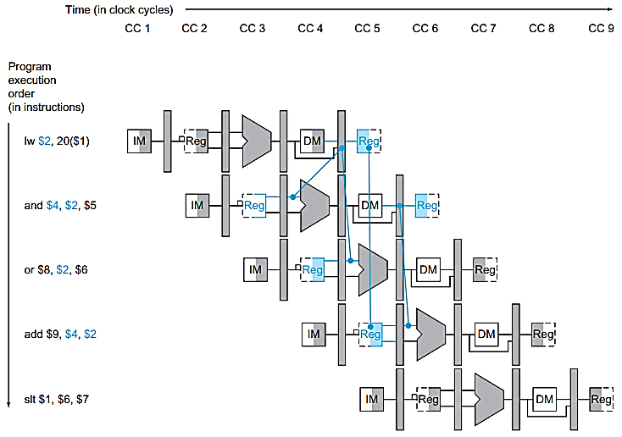
Data Hazards – Example 5 Pipeline Diagram

Slide 33
Data Hazards – Example 5 Pipeline Diagram

Slide 34
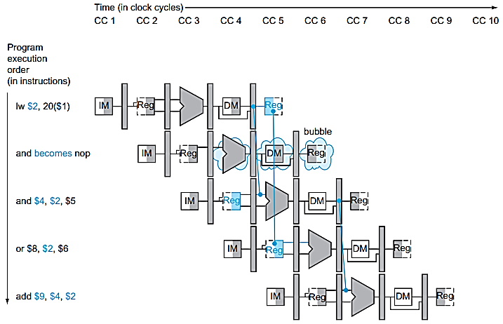
Data Hazards – Example 5 Solution Stall
Nop: An instruction that does no operation to change state
Notes:
FIGURE 4.59 The way stalls are really inserted into the pipeline. A bubble is inserted beginning in clock cycle 4, by changing the and instruction to a nop. Note that the and instruction is really fetched and decoded in clock cycles 2 and 3, but its EX stage is delayed until clock cycle 5 (versus the unstalled position in clock cycle 4). Likewise the OR instruction is fetched in clock cycle 3, but its ID stage is delayed until clock cycle 5 (versus the unstalled clock cycle 4 position). Aft er insertion of the bubble, all the dependences go forward in time and no further hazards occur

Slide 35
Data Hazard – Practice Problems
Make pipeline diagram for the code segment given below, and identify data dependences and hazards.
(a)
lw $2, 20($1)
and $4, $2, $5
or $8, $2, $4
add $9, $4, $2
slt $1, $6, $7
(b)
lw $2, 20($1)
add $3, $4,$5
and $4, $2, $5
or $8, $2, $4
add $9, $4, $2
slt $1, $6, $7

Slide 36
Pipeline Stall
Pipeline Stall (Bubble): A stall initiated in order to resolve a hazard.
Load-use data hazard: A specific form of data hazard in which the data being loaded by a load instruction has not yet become available when it is needed by another instruction.
Bubbling the pipeline, also termed a pipeline break or pipeline stall, is a method to preclude data, structural, and branch hazards. As instructions are fetched, control logic determines whether a hazard could/will occur. If this is true, then the control logic inserts no operations (NOPs) into the pipeline. Thus, before the next instruction (which would cause the hazard) executes, the prior one will have had sufficient time to finish and prevent the hazard. If the number of NOPs equals the number of stages in the pipeline, the processor has been cleared of all instructions and can proceed free from hazards. All forms of stalling introduce a delay before the processor can resume execution.

Slide 37
Example 6 -Reordering Code to Avoid Pipeline Stalls
Consider the following code segment in C:
a = b + e;
c = b + f;
Here is the generated MIPS code for this segment, assuming all variables are in
memory and are addressable as off sets from $t0:
lw $t1, 0($t0)
lw $t2, 4($t0)
add $t3, $t1,$t2
sw $t3, 12($t0)
lw $t4, 8($t0)
add $t5, $t1,$t4
sw $t5, 16($t0)
Find the hazards in the preceding code segment and reorder the instructions to avoid any pipeline stalls
Practice Question: Make Pipeline Execution for following code, properly show hazards fixes.

Slide 38
Example 6 -Reordering Code to Avoid Pipeline Stalls (Contd.)
Solution:
lw $t1, 0($t0)
lw $t2, 4($t0)
lw $t4, 8($t0)
add $t3, $t1,$t2
sw $t3, 12($t0)
add $t5, $t1,$t4
sw $t5, 16($t0)
On a pipelined processor with forwarding, the reordered sequence will complete in two fewer cycles than the original version.
Practice Question: Make Pipeline Execution for following code, properly show hazards fixes.

Slide 39
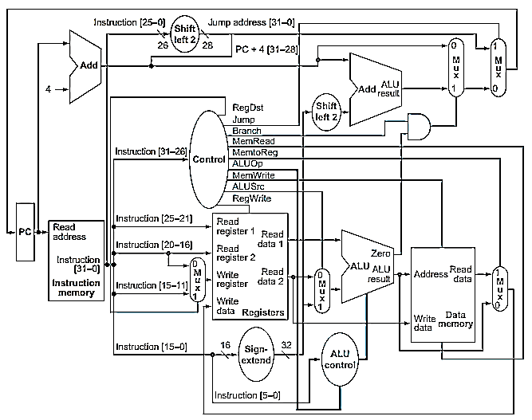
Branch Instruction Operation on Datapath

Slide 40
Branch Instruction Operation on Datapath
1
4
3
5
0
2

Slide 41
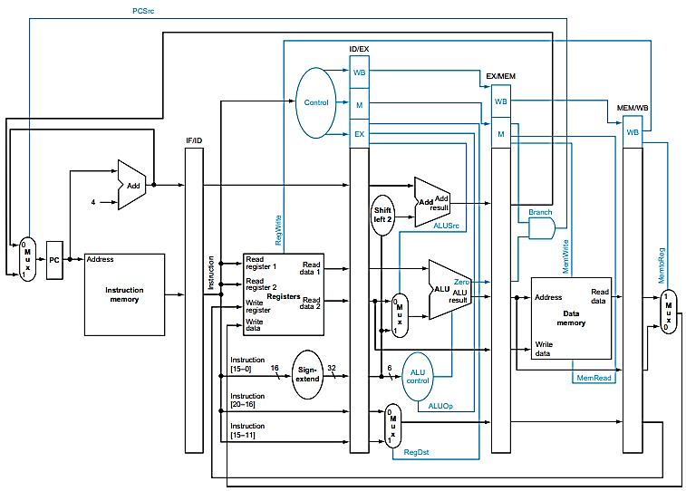
Branch Instruction Operation on Pipelined Datapath
Notes:
FIGURE 4.60 Pipelined control overview, showing the two multiplexors for forwarding, the hazard detection unit, and the forwarding unit. Although the ID and EX stages have been simplifi ed—the sign-extended immediate and branch logic are missing— this drawing gives the essence of the forwarding hardware requirements.

Slide 42
Branch Instruction Operation on Pipelined Datapath
3
2
5
4
1
Notes:
FIGURE 4.60 Pipelined control overview, showing the two multiplexors for forwarding, the hazard detection unit, and the forwarding unit. Although the ID and EX stages have been simplifi ed—the sign-extended immediate and branch logic are missing— this drawing gives the essence of the forwarding hardware requirements.

Slide 43
Example 7 – Pipeline Branch
Draw pipeline diagram for the code segment given below:
36 sub $10, $4, $8
40 beq $1, $3, 7 # PC-relative branch to 40 + 4 + 7 * 4 = 72
44 and $12, $2, $5
48 or $13, $2, $6
52 add $14, $4, $2
56 slt $15, $6, $7
. . .
72 lw $4, 50($7)

Slide 44
Example 7 – Pipeline Branch
Draw pipeline diagram for the code segment given below:
36 sub $10, $4, $8
40 beq $1, $3, 7 # PC-relative branch to 40 + 4 + 7 * 4 = 72
44 and $12, $2, $5
48 or $13, $2, $6
52 add $14, $4, $2
56 slt $15, $6, $7
. . .
72 lw $4, 50($7)
 | CC1
sub $10, $4, $8 | IF

Slide 45
Example 7 – Pipeline Branch
Draw pipeline diagram for the code segment given below:
36 sub $10, $4, $8
40 beq $1, $3, 7 # PC-relative branch to 40 + 4 + 7 * 4 = 72
44 and $12, $2, $5
48 or $13, $2, $6
52 add $14, $4, $2
56 slt $15, $6, $7
. . .
72 lw $4, 50($7)
 | CC1 | CC2
sub $10, $4, $8 | IF | ID
beq $1, $3, 7 |  | IF

Slide 46
Example 7 – Pipeline Branch
Draw pipeline diagram for the code segment given below:
36 sub $10, $4, $8
40 beq $1, $3, 7 # PC-relative branch to 40 + 4 + 7 * 4 = 72
44 and $12, $2, $5
48 or $13, $2, $6
52 add $14, $4, $2
56 slt $15, $6, $7
. . .
72 lw $4, 50($7)
 | CC1 | CC2 | CC3
sub $10, $4, $8 | IF | ID | EX
beq $1, $3, 7 |  | IF | ID
??? |  |  | IF?

Slide 47
Branch Prediction
How to handle Branches? Solution: Branch Prediction
Branch Prediction Strategies:
Always Untaken i.e. fetch instruction at PC + 4
Always Taken i.e. PC = PC + 4 + Offset
Delayed Branch i.e. add some code between branch instruction and target instruction
Some branches always taken and some branches always not taken e.g. at the bottom of loops are branches that jump back to the top of the loop
Dynamic Prediction on the basis of history of a branch
When the guess is wrong, the pipeline control must ensure that the instructions following the wrongly guessed branch have no effect and must restart the pipeline from the proper branch address.

Slide 48
Example 7 – Pipeline Branch
Draw pipeline diagram for the code segment given below:
36 sub $10, $4, $8
40 beq $1, $3, 7 # PC-relative branch to 40 + 4 + 7 * 4 = 72
44 and $12, $2, $5
48 or $13, $2, $6
52 add $14, $4, $2
56 slt $15, $6, $7
. . .
72 lw $4, 50($7)
 | CC1 | CC2 | CC3
sub $10, $4, $8 | IF | ID | EX
beq $1, $3, 7 |  | IF | ID
and $12, $2, $5 |  |  | IF

Slide 49
Example 7 – Pipeline Branch
Draw pipeline diagram for the code segment given below:
36 sub $10, $4, $8
40 beq $1, $3, 7 # PC-relative branch to 40 + 4 + 7 * 4 = 72
44 and $12, $2, $5
48 or $13, $2, $6
52 add $14, $4, $2
56 slt $15, $6, $7
. . .
72 lw $4, 50($7)
Have you noticed any problem?
Is our prediction Correct?
When will we get to know if the prediction was correct or not?
 | CC1 | CC2 | CC3 | CC4
sub $10, $4, $8 | IF | ID | EX | MEM
beq $1, $3, 7 |  | IF | ID | EX
and $12, $2, $5 |  |  | IF | ID
or $13, $2, $6 |  |  |  | IF

Slide 50
Branch Instruction Operation on Pipelined Datapath
3
CC4
CC4
2
5
4
1
t5
t6
CC5
CC3
t4
Notes:
FIGURE 4.60 Pipelined control overview, showing the two multiplexors for forwarding, the hazard detection unit, and the forwarding unit. Although the ID and EX stages have been simplifi ed—the sign-extended immediate and branch logic are missing— this drawing gives the essence of the forwarding hardware requirements.

Slide 51
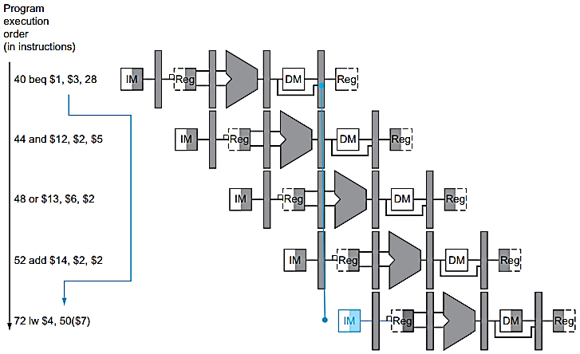
Example 7 – Strategy: Always NOT Taken
CC1
CC2
CC3
CC4
CC5
CC6
CC7
Flush: To discard instructions in a pipeline, usually due to an unexpected event

Slide 52
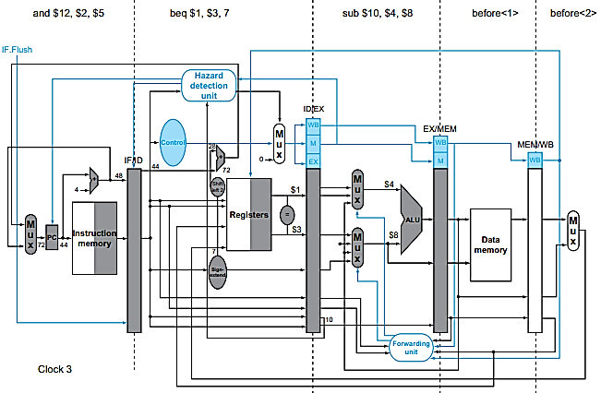
Branch with Datapath Optimization
Flush: To discard instructions in a pipeline, usually due to an unexpected event
Branch
Branch

Slide 53
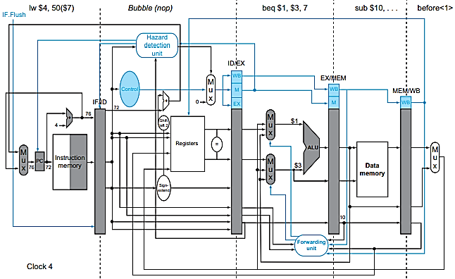
Flush: To discard instructions in a pipeline, usually due to an unexpected event
$0, $0, 0
Branch with Datapath Optimization

Slide 54
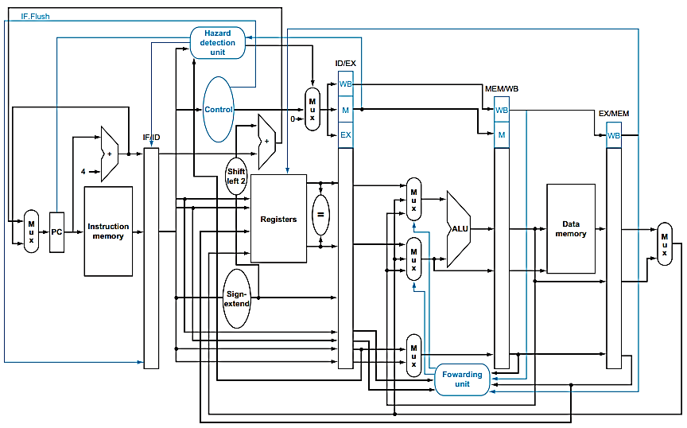
Pipelined Datapath

Slide 55
Example 7 – Pipeline Branch
Draw pipeline diagram for the code segment given below:
36 sub $10, $4, $8
40 beq $1, $3, 7 # PC-relative branch to 40 + 4 + 7 * 4 = 72
44 and $12, $2, $5
48 or $13, $2, $6
52 add $14, $4, $2
56 slt $15, $6, $7
. . .
72 lw $4, 50($7)
 | CC1 | CC2 | CC3 | CC4
sub $10, $4, $8 | IF | ID | EX | MEM
beq $1, $3, 7 |  | IF | ID | EX
and $12, $2, $5 |  |  | IF | Bubble
lw $4, 50($7) |  |  |  | IF

Slide 56
Example 7 – Pipeline Branch
Draw pipeline diagram for the code segment given below:
36 sub $10, $4, $8
40 beq $1, $3, 7 # PC-relative branch to 40 + 4 + 7 * 4 = 72
44 and $12, $2, $5
48 or $13, $2, $6
52 add $14, $4, $2
56 slt $15, $6, $7
. . .
72 lw $4, 50($7)
 | CC1 | CC2 | CC3 | CC4 | CC5
sub $10, $4, $8 | IF | ID | EX | MEM | WB
beq $1, $3, 7 |  | IF | ID | EX | MEM
and $12, $2, $5 |  |  | IF | Bubble | Bubble
lw $4, 50($7) |  |  |  | IF | ID
Next Instruction |  |  |  |  | IF

Slide 57
Example 7 – Pipeline Branch
Draw pipeline diagram for the code segment given below:
36 sub $10, $4, $8
40 beq $1, $3, 7 # PC-relative branch to 40 + 4 + 7 * 4 = 72
44 and $12, $2, $5
48 or $13, $2, $6
52 add $14, $4, $2
56 slt $15, $6, $7
. . .
72 lw $4, 50($7)
 | CC1 | CC2 | CC3 | CC4 | CC5 | CC6 | CC7 | CC8 | CC9
sub $10, $4, $8 | IF | ID | EX | MEM | WB
beq $1, $3, 7 |  | IF | ID | EX | MEM | WB
and $12, $2, $5 |  |  | IF | Bubble | Bubble | Bubble | Bubble
lw $4, 50($7) |  |  |  | IF | ID | EX | MEM | WB
Next Instruction |  |  |  |  | IF | ID | EX | MEM | WB

Slide 58
Control Hazards (Branch Hazards)
Hazard arising from the need to make a decision based on the results of one instruction while others are executing.
Control hazard occurs when the pipeline makes wrong decisions on branch prediction and therefore brings instructions into the pipeline that must subsequently be discarded.
The term branch hazard also refers to a control hazard.
We must begin fetching the instruction following the branch on the very next clock cycle. Nevertheless, the pipeline cannot possibly know what the next instruction should be, since it only just received the branch instruction from memory!

Slide 59
Summary – Pipeline Hazards
Three type of Pipeline Hazards
Structural Hazard
Add Resource
Stall
Data Hazard
Forwarding
Stall the Pipeline
Control Hazard
Stall

Slide 60
Reference
David A. Patterson, John L. Hennessy, Computer Organization and Design: The hardware/software interface – Chapter 4.
https://en.wikipedia.org/wiki/Hazard_(computer_architecture)

